Slide 1
CSE3008 Introduction to Machine Learning Lab Mini project Insurance premium prediction Dataset
Submitted by
Batch 12
20BCD7091 MRK SAKETH
20BCD7092 K.SAI DEEPAK
20BCE7177 K.KRISHNA KISHORE

Slide 2
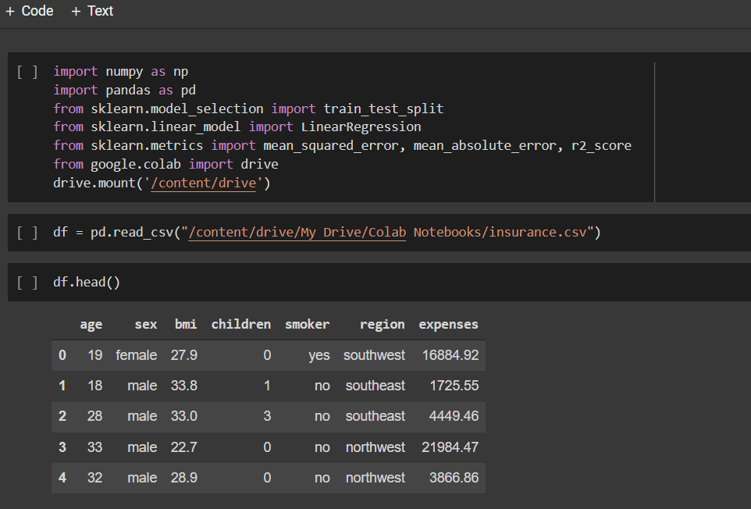
Importing datasets and libraries

Slide 3
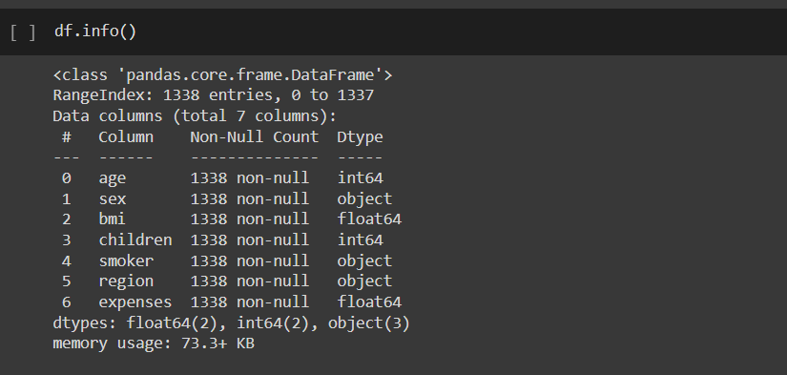

Slide 4
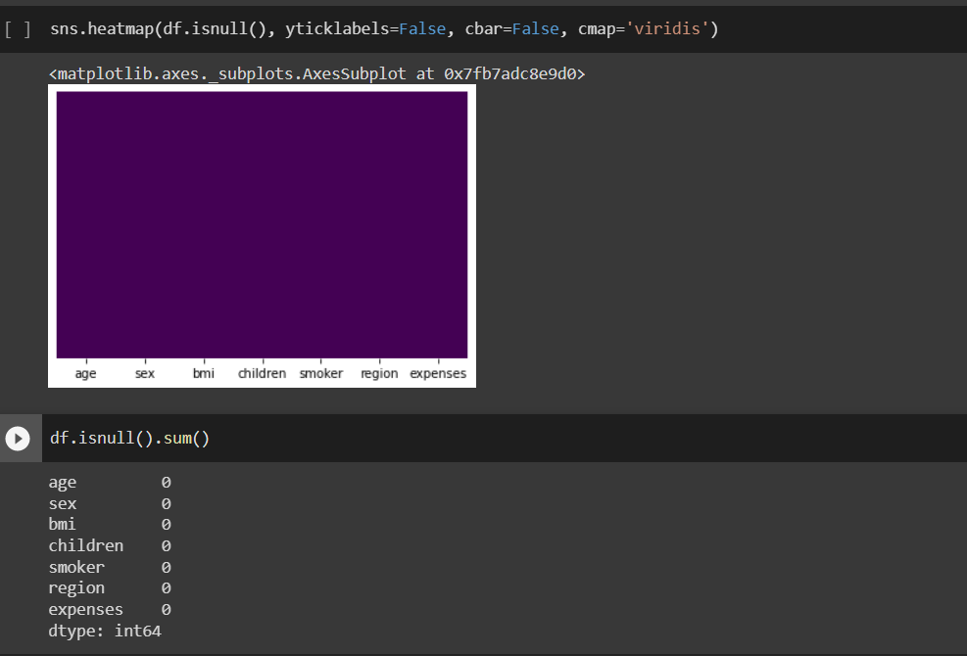

Slide 5
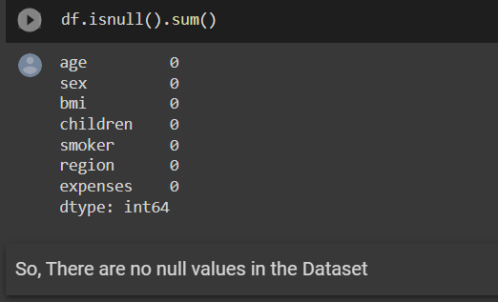

Slide 6
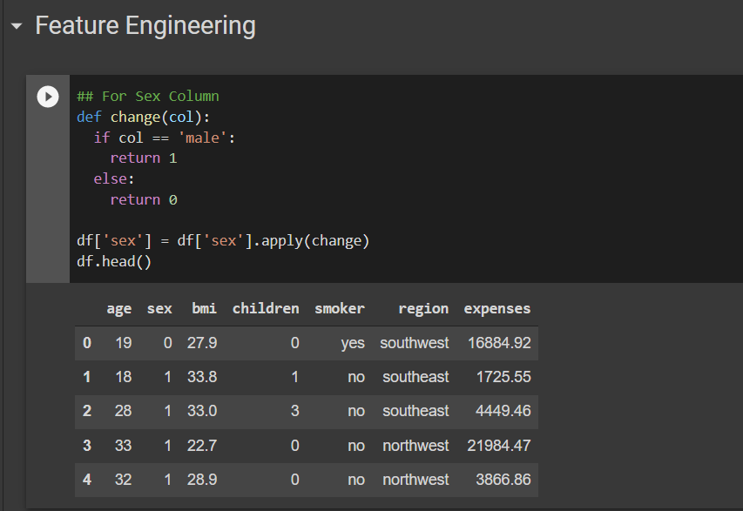

Slide 7
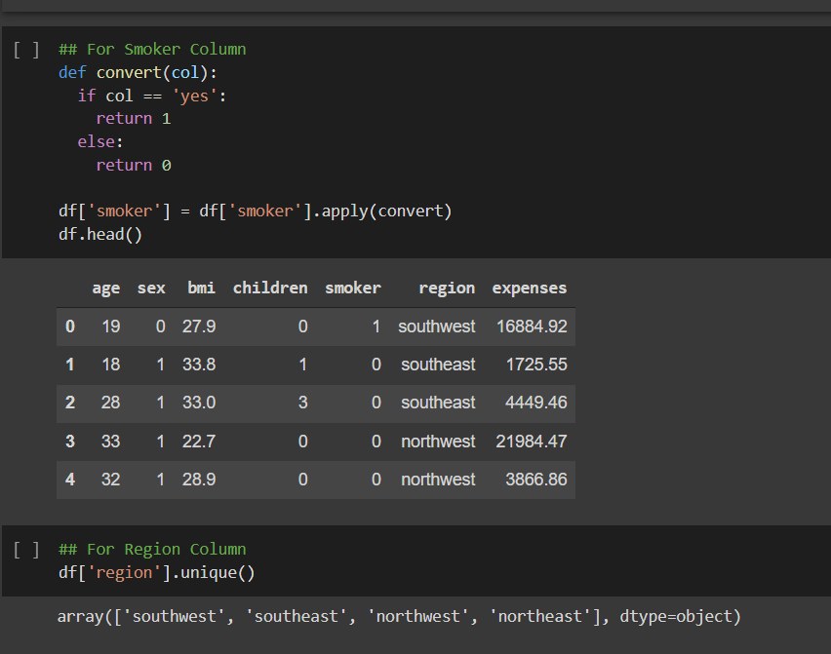

Slide 8
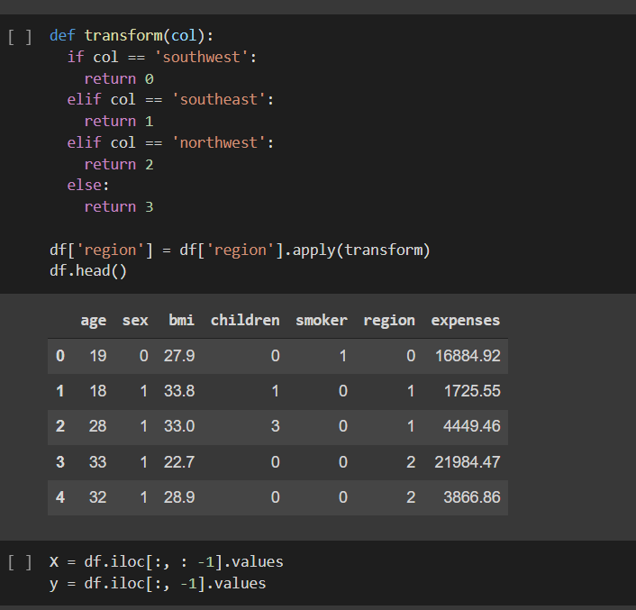

Slide 9
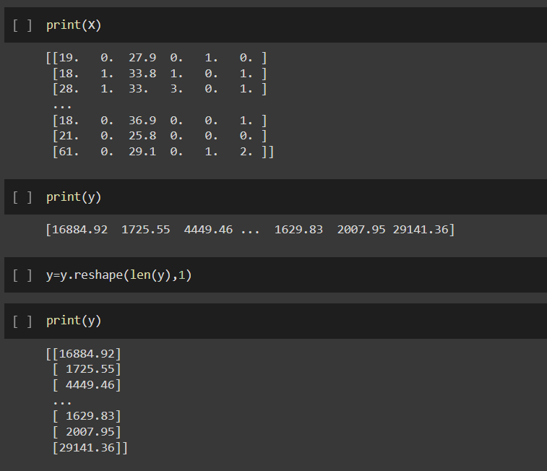

Slide 10
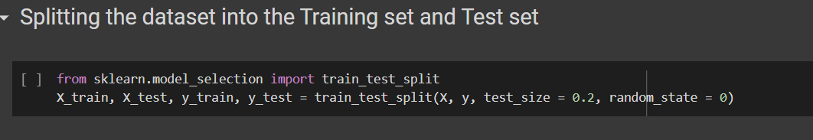

Slide 11
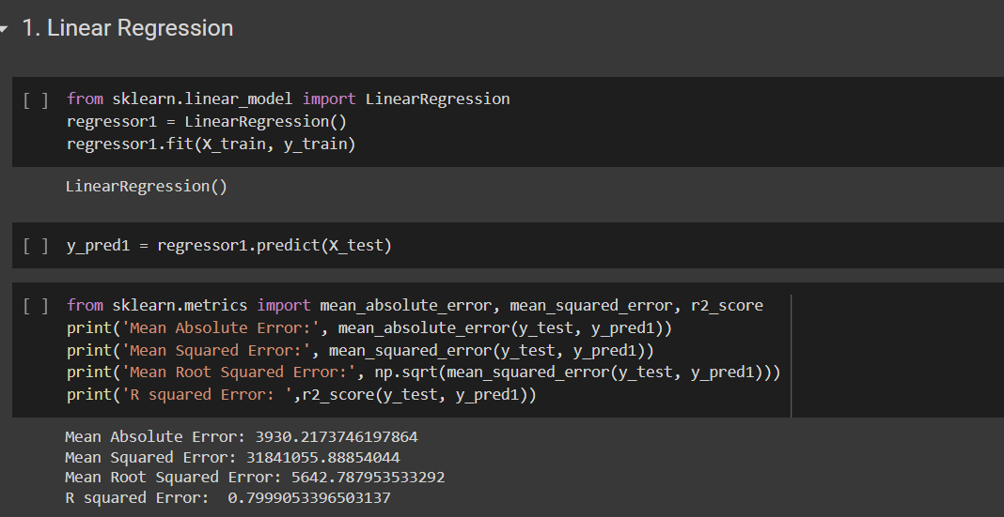
LINEAR REGRESSION

Slide 12
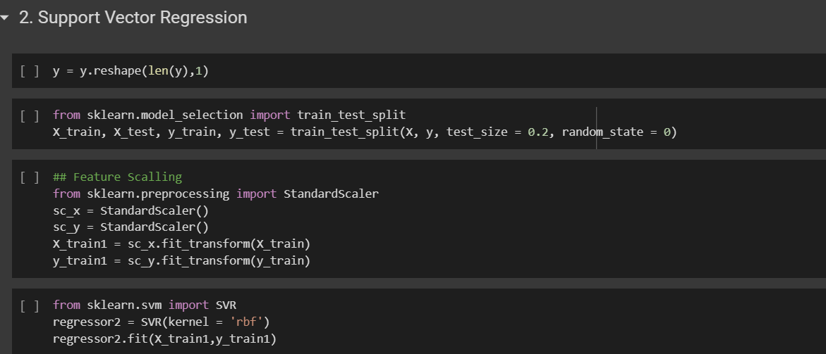
Support Vector Regression

Slide 13
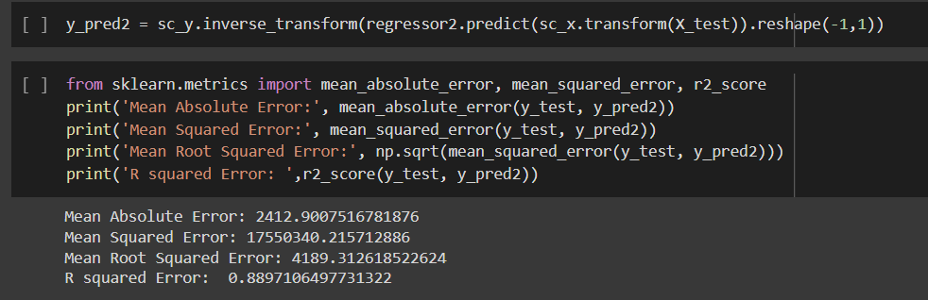

Slide 14
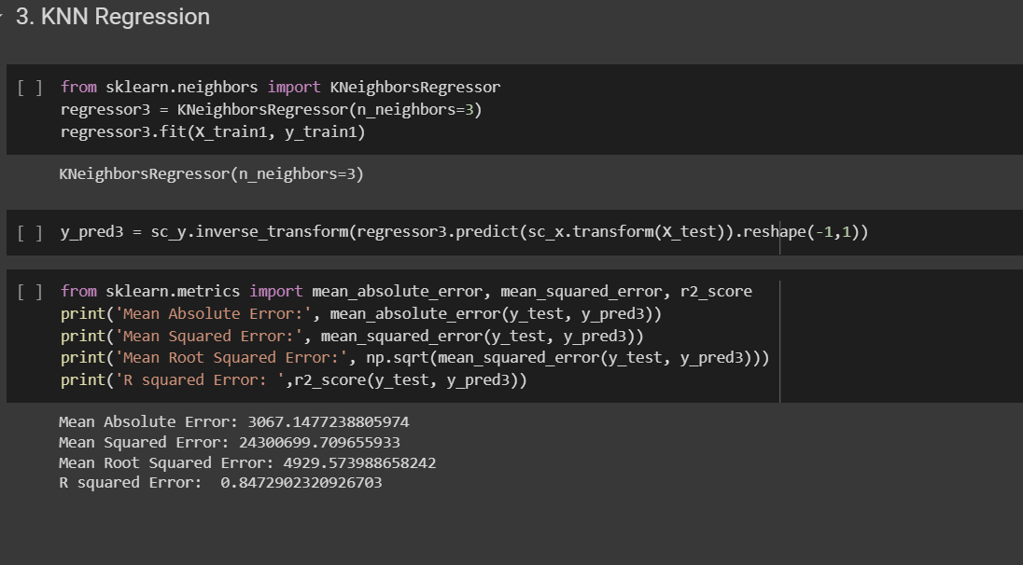
KNN Regression

Slide 15
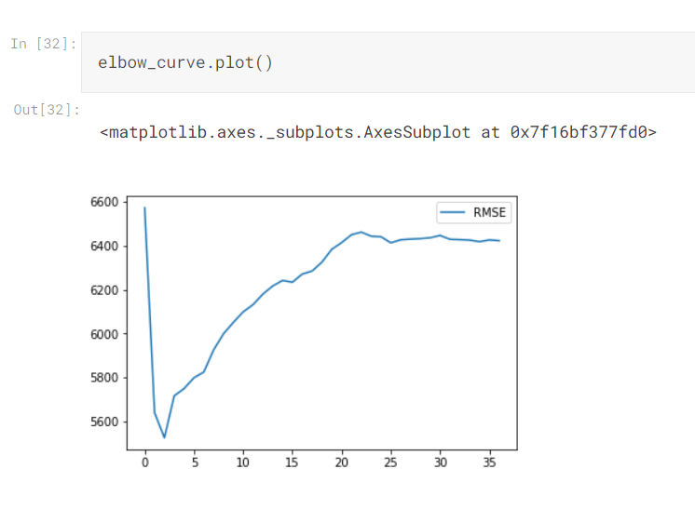
Plot

Slide 16
THANK YOU

